Slide 1
Module 5.3.2: Tuples and sets

Slide 2
Advanced Data Structures

Slide 3
How Variables Work
5
Let’s save a number:
num = 5
What just happened?
Python saved the number 5 someplace in the computer’s memory,
then gave us back a pointer named num.
This pointer has a name (num) and knows where to look for the value (5) in the computer’s memory.
num

Slide 4
And a list?
What if we do the same thing with a list?
numbers = [8, 6, 4, 2]
The same thing happens!
The list is created in memory, and a pointer named numbers is given back to us.
This pointer knows where to find the list data in the computer’s memory.
8
6
4
2
numbers

Slide 5
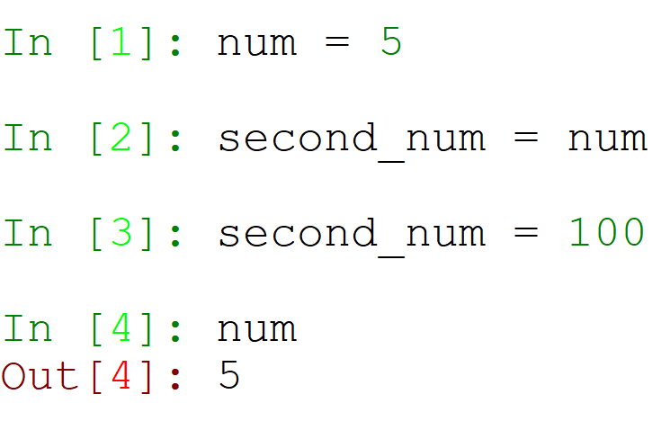
But check out the difference…
Create a variable
Make a copy
Change the copy
What happens to the original?
It did not change.

Slide 6
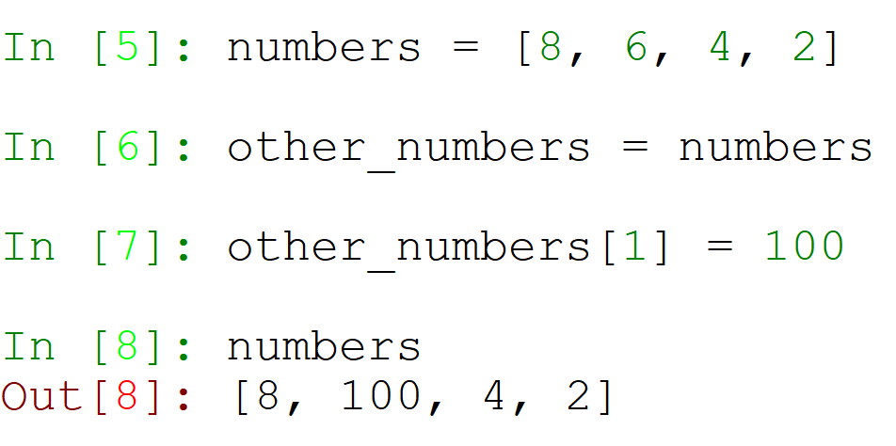
And lists?
Create a variable
Make a copy
Change the copy
What happened to the original?
It changed!

Slide 7
Wait, what??
Create a variable
Make a copy
Change the copy
The list changes.
The integer does not.

Slide 8
Let us see what is happening behind the scenes…
num
num = 5
second_num = num
second_num = 100
5
second_num
100

Slide 9
Behind the scenes with lists…
numbers = [8, 6, 4, 2]
other_numbers = numbers
other_numbers[1] = 100
numbers
8
100
6
4
2
other_numbers

Slide 10
There are two categories of types
All types in Python are either mutable or immutable.
Mutable types can be changed!
Immutable types cannot be changed.

Slide 11
Mutable vs. Immutable Types
Mutable | Immutable
list | int
 | float
 | str
 | tuple
 | bool

Slide 12
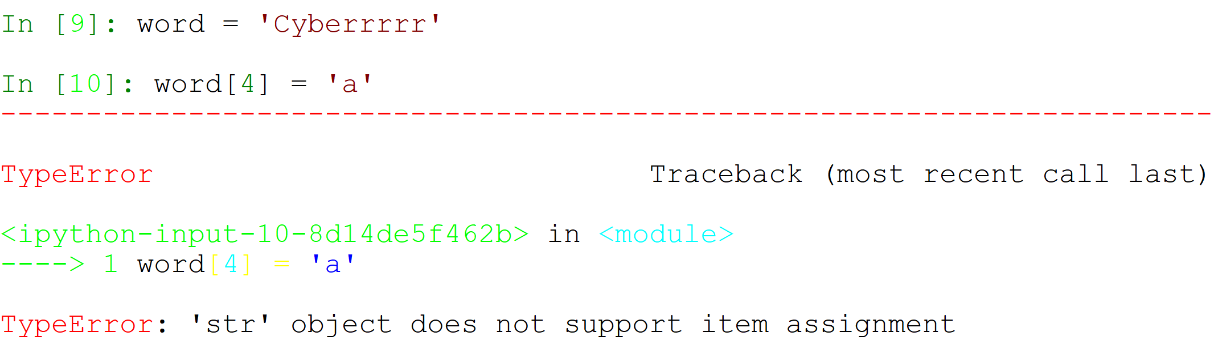
Let us check!
Why did this happen?
Because strings are immutable!

Slide 13
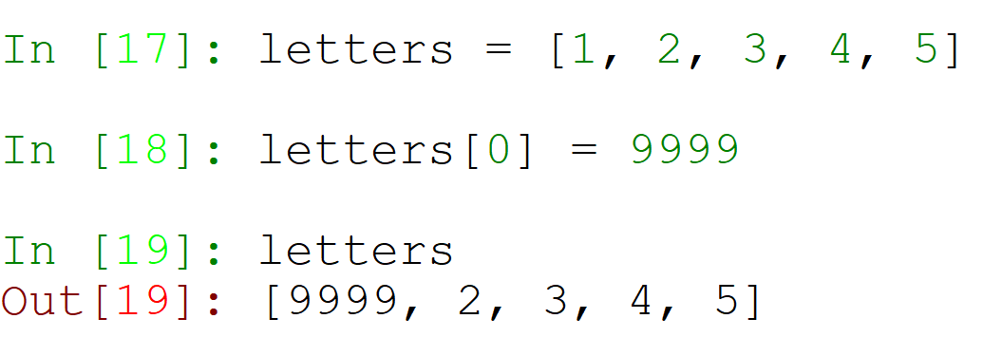
Let’s check!
Why did this happen?
Because lists are mutable!

Slide 14
Tuples

Slide 15
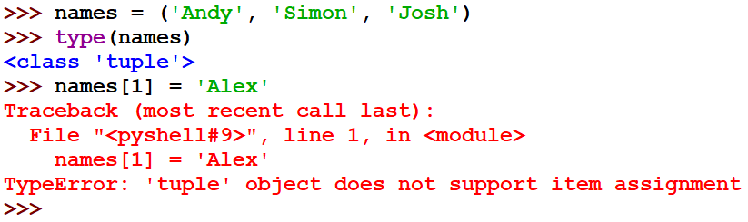
Tuples
Tuples are very similar to lists. They differ only in that tuples cannot be modified.
To define a tuple, you use regular parentheses – () – instead of square brackets.

Slide 16
List vs Tuple
Lists
Tuples
Define
Square Brackets - [ ]
Regular Brackets - Parentheses - ( )
Add data
Remove data
Change data
Attributes
Cannot be changed
Size
Runtime

Slide 17
List vs Tuple - Size
Lists occupies more memory than tuples!
In order to measure and demonstrate the size difference, we will have to import to sys module!
The sys module consists of the getsizeof() function, which returns the size of an object in bytes!

Slide 18
List vs Tuple - Time
Tuples can be made more quickly than lists!
In order to measure the time difference, we will have to import the timeit module.
The timeit module consists of the timeit() function, which returns how long it takes to finish a process!

Slide 19
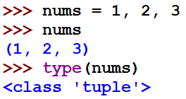
Packing
Tuples are very useful in Python. In fact, they are so embedded in the language that you don’t even need parentheses to define them!
This is called packing.

Slide 20
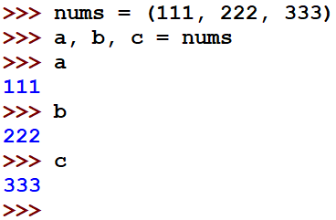
Unpacking
Unpacking is the exact opposite of packing – it takes a tuple and divides it into different variables.

Slide 21
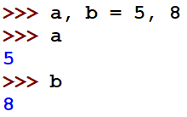
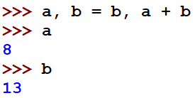
Packing - Unpacking
This is a very, very useful technique in Python – this uses both packing and unpacking to put multiple values into multiple variables.
This can be used to switch between two variables without use of a third, or to do more complex calculations.

Slide 22
Tuples Summary
The Tuple Type
Tuples VS Lists
Packing
Unpacking

Slide 23
Sets

Slide 24
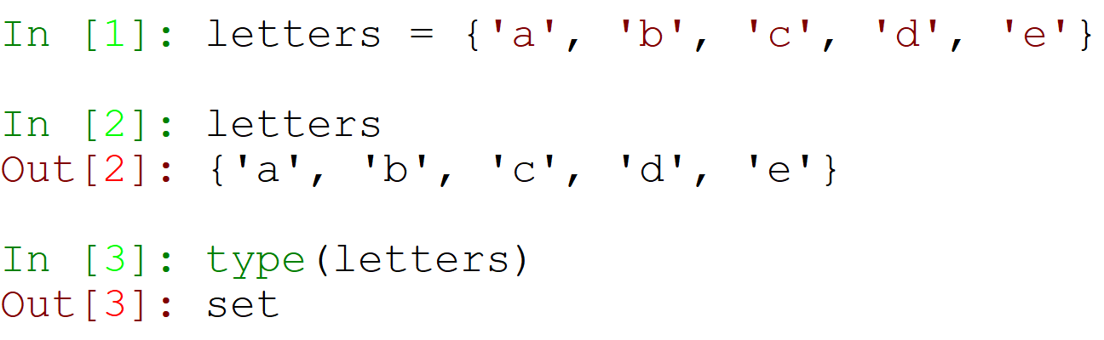
Creating a Set
Sets are a new sequence type, created using curly brackets:

Slide 25
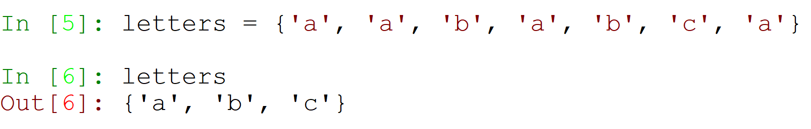
Set Qualities
Sets have two main qualities:
Sets do not have any specific order.
They do not even support indexing!
Sets hold only distinct values.
This means that there are no duplicate values!

Slide 26
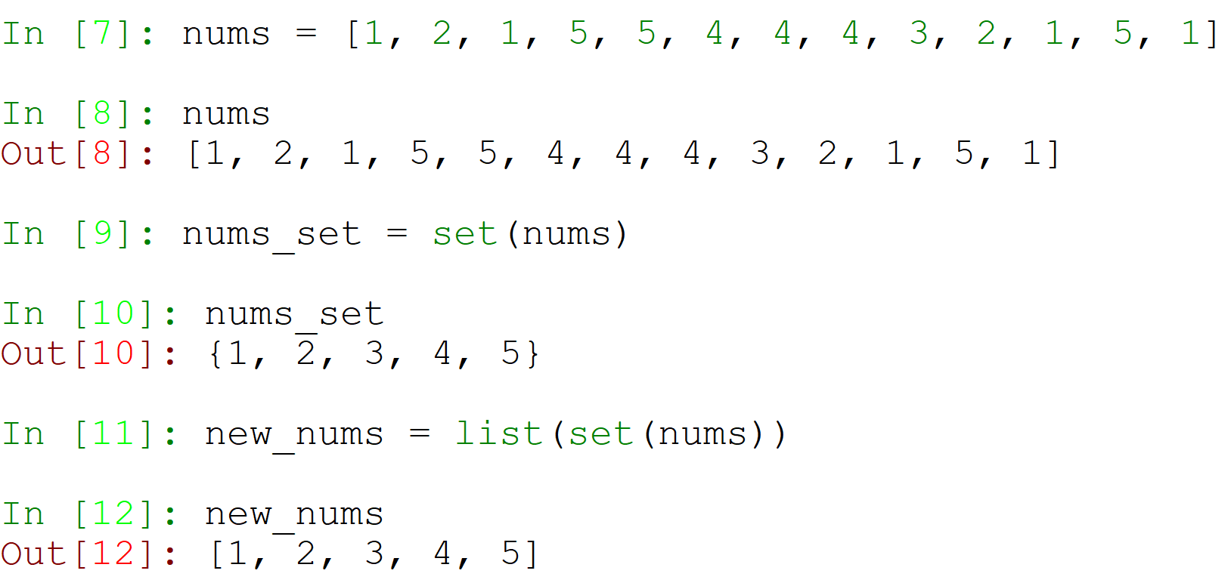
Creating a Distinct List
Problem:
The result can be any order!

Slide 27
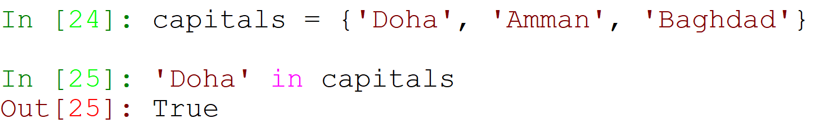
Using the in Keyword
Just like in lists, tuples, and dicts – using the in keyword can check if an item is in the set.

Slide 28
Set Methods and Operators
Method Name | Explanation | Example
add | Adds a new value to the set | {1, 2, 3}.add(4)
remove | Removes a value from the set | {1, 2, 3}.remove(2)
intersection | Returns a set with the items in the set that appear in the second set. | {1, 3, 5}.intersection({3, 4, 5}) >>> {3, 5}
set1 – set2 | Returns a set with the items in set1 that don’t appear in set2. | {1, 3, 5} – {3, 4, 5} >>> {1}
issubset | Returns True/False, depending on if all items in the set appear in the second set. | {0, 4, 7}.issubset(set(range(10))) >>> True

Slide 29
Mutable vs. Immutable Types
Mutable | Immutable
list | int
dict | float
set | str
 | tuple
 | bool

Slide 30
What did we learn?
Sets
Qualities
Methods

